Slide 1
Venue Scraper
CSC 154.0012024 FA
Group 4

Slide 2
Introduction to Team
CJ Coronado – Project Manager. Owner of Shirley Road Records. Created the proto-venue scraper which inspired our project.
James Dove – Database Designer. Experienced in C++ and Python. Currently part of three group projects.
Katelyn Doyle – Requirements Analyst / User Experience (UX) Designer. Defined and developed client side for 2 web application projects. Beginner wireframe creator. Python certified.
Raegan Durdin – Business Analyst / Researcher. Has experience in C++, Python, and Java. Been in a multitude of projects with hands on experience using all 3 programming languages.
Sha He – Software Architect. Strong background in defining project scope, setting technical constraints, and identifying critical exclusions to streamline development and align with business goals. Deep understanding of software engineering principles, including best practices in API development, web scraping with anti-scraping mechanisms, and database management for optimized querying and filtering.
Fatima Zaid - Software Architect. Project-focused and growth-oriented approach to software development.

Slide 3

Intro to Team Collaboration and Project Management
Microsoft Teams
Mobile
Flexible
Repository
Live Edit
Agile Focused*
Springing to the goal
Collaboration
User Stories
* Eliminated scheduled meetings, opted for weekly bulletin board

Slide 4
Project Overview and Description
This project aims to develop a web-based software solution for Shirley Road Records, a Durham-based music business, to maximize projected ticket sales for concerts. The solution will automate the data collection process from multiple concert venues, perform ticket sales analysis using regression models, and provide users with a dashboard to manage, view, and analyze the collected data.
This project combines elements of data collection, cleaning, automation, regression analytics, web scraping, and reporting to aid Shirley Road in selling more concert tickets.

Slide 5
Project Features and User Stories
Features and Functions:
User Login and Access Management
Venue Search and Filtering Functionality
Data Scraping and Automatic Updates
Database Management
User Interface
Backend Development and API Design
User Stories:
Booking agents want to:
Be able to search through available venues
Be able to compare event history (profit and popularity)
Venue Owners want to:
Access and compare ticket sales history for bands

Slide 6
Use Cases
Use Case 1
Actor: User (Visitor)
Goal: View a list of venues already scraped by the system.
Steps:
User visits the web scraper application’s homepage.
System displays a list of venues that have already been scrapped.
User can filter the list by
Venue Type
Location
Event Date
System updates the venue list based on the filters selected by the User.
User clicks on a specific venue to view more detailed information (e.g., address, upcoming events).
System presents detailed venue information to the User.
Use Case 2
Actor: User (Visitor)
Goal: Search for a specific venue from the list of scraped venues.
Steps:
User accesses the search bar on the web scraper application.
User inputs the name of a venue or keywords (e.g., "concert hall" or "outdoor space").
System searches the scraped venue database for matching results.
System displays the list of matching venues to the User.
User clicks on a venue to view detailed information.
System presents detailed information (e.g., capacity, events, contact info) about the venue.
Use Case 3
Actor: User (Application)
Goal: Update system with most up to date information
Steps:
Option A:
Customer logs into the system.
Customer views home page.
Scraper runs and pulls in the most up to date information.
Option B:
User refreshes the page.
Scraper runs and pulls in the most up to date information.
Option C:
After a certain amount of time has passed,
Scraper runs and pulls in the most up to date information.

Slide 7
Project Scope
Development of Multi-Venue Web Scrapers:
Extend the existing web scraper to collect data from multiple concert venues.
Ensure flexibility to easily add or modify scraping for new venues as needed.
Data fields to be collected include band/artist, venue, ticket price, and date.
Backend Data Processing:
Data normalization and formatting for easy insertion into an Excel sheet or database.
Implement a system to process and prepare scraped data for analysis.
R Integration for Analysis:
Use R for regression analysis on the data to predict ticket sales potential.
Create a workflow where users can trigger R scripts to run analysis on selected data.
User Interface Development:
Build a front-end dashboard where users can view, manage, and analyze data.
Display sales projections and analysis results in a clear, intuitive format (e.g., charts, graphs, ranked lists).
System Testing and Validation:
Validate that the web scraper collects accurate and complete data.
Ensure the system integrates correctly with the R analysis tools.
Perform performance testing to ensure the UI and data analysis processes are smooth and user-friendly.

Slide 8
Excluded Features and Constraints
User Login and Access Management
No need to develop complex user management functionality.
Advanced Recommendation System
Only basic filtering and sorting of data are supported, without complex AI-based recommendation algorithms.
Mobile Platform Support
The project will focus on web development, without mobile platform support.
Internationalization Support
The project will only support English and will not include multi-language versions.
Time Constraints
The project will be completed within four sprint cycles.
Technical Requirements:
Ensure that the scraper tool can bypass anti-scraping mechanisms to reliably collect data.
The database must support efficient data querying and filtering for sales prediction analysis.
Dependencies:
The project depends on third-party websites (venue websites) for data. Changes in these sources may affect project progress.

Slide 9
Business Requirements
Business Must:
Provide an application that accurately scrapes information from a list of websites, stores the information, and accurately displays it to the user.
Business Should:
Make this application user-friendly for users with appealing features, including but not limited to easy search filtering.
Business Should:
Have information stay up to date, so the web scraper periodically scrapes for information and updates the application as needed to stay ahead of other similar applications.
Business Could:
Have a more specific scope of search so that the application has a larger scope of use and is not limited to one area so that lots of people can use the application.

Slide 10
User Requirements
Users Must:
Be able to create and log in to an account
Be able to pull and compares sale's performance data
Users Should:
Be able to search and filter for venues
Users Could:
Be able to save venues and store them in a library
Users Won't:
Be able to create promotional material and tickets

Slide 11

Non-Functional Requirements
The Program Must:
Be able to scrape multiple websites simultaneously.
Be able to accommodate a growing userbase.
The Program Should:
Have an intuitive and user-friendly to navigate.
The Program Could:
Have a robust security system for future use as a website.

Slide 12
Security and Hardware
Authentication and Authorization
Ensures safety by having people log in before accessing the system.
Two-factor authentication nearly guarantees that it’s you logging in.
We will use two-factor authentication to ensure that no hacker can get in.
For the logged in users, we will make sure that they’re authorized by giving them permissions and frequently checking those to make sure they’re up to date.
Data Protection: Ensuring Sensitive Data Security During Transmission and Storage
Data Encryption in Transit
Data Masking and Tokenization
Logging and Monitoring
Tracking all actions made to the system (by web scrapers, APIs, users, etc.)
See who is contributing to the system (get usage statistics to improve it)
If an error occurs, the information can be found (tied to a user, timestamp, etc.)
This will help us debug errors faster and eliminate security threats faster
Processor Requirements:
The program requires scraping of multiple websites simultaneously, which can be taxing. A multi-core processor, such as Intel i7 or AMD Ryzen 5 is preferred.
Memory Requirements:
16GB of RAM is the recommended minimum. If the stakeholder plans to expand their operations, they should upgrade to 32GB.
Storage Requirements:
The program will need to store information about the venues and bands to perform its calculations. A 500GB SSD is sufficient.

Slide 13
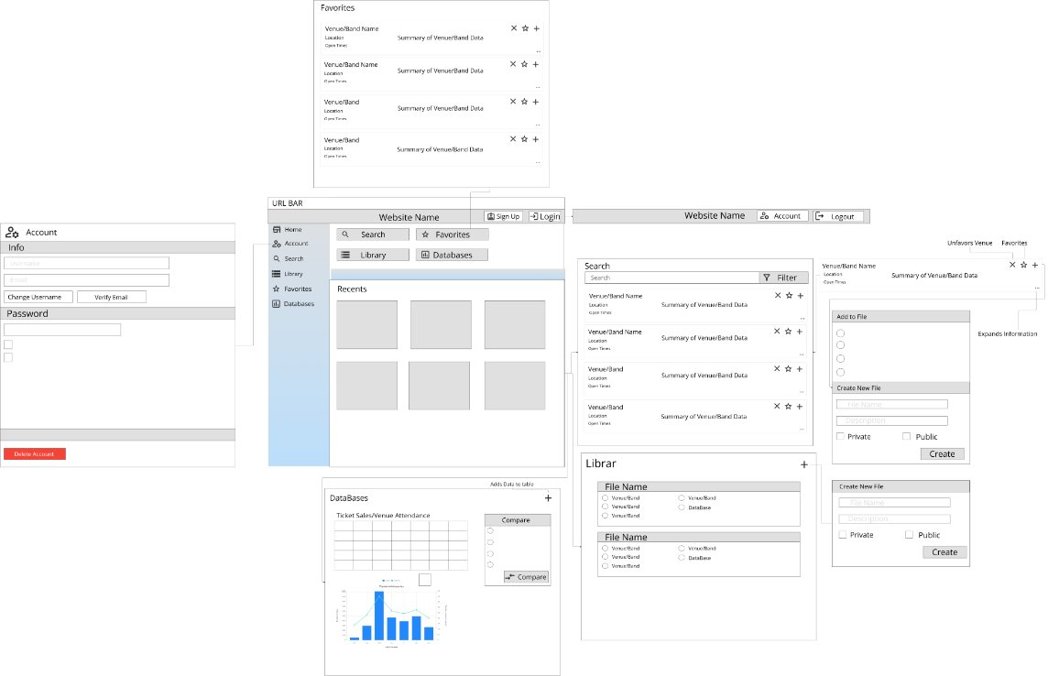
UX
Usability Requirements
Consistent styling, universal symbols, and filter features
User Flow & Navigation
Side Bar Navigation, Pop-up help guides
Responsiveness & Performance
30 seconds max search time and instant page load
Feedback & Error Handling
Success messages and optional error report features
User Profiles & Personalization
Username and password editability, Library save feature
Venue Scraper Wireframe

Slide 14
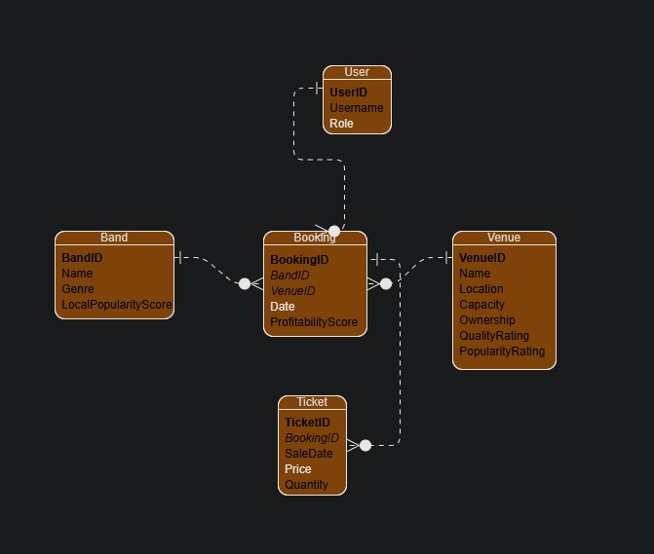
Architecture and Database
Component-based Architecture
Individual systems (components) that interact with each other but run separately
Allows you to easily improve the systems individually and run them together, too
In our project, our 3 three distinct components all serve different purposes
Data collection
Web Scraping
APIs
Data storage component
Excel (prototype)
Data analysis component
Ridge Regression
Forecast
These components are combined into a dataflow: Collection → Storage → Analysis
Considering the scalability and processing requirements of the program, a cloud-based relational database management system is recommended.
Amazon RDS is a good choice. It offers:
Automatic backups.
Software patching.
Easy scaling
Integrates with other AWS services.

Slide 15

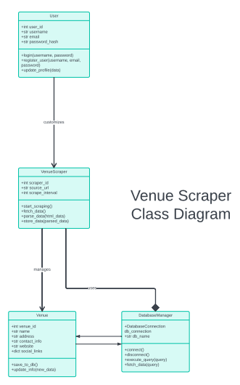
Top-Level Classes
To show what kind of classes the application would use and how everything is structured, a Venue Scraper Class Diagram has been created that shows the classes and variables related to each one.

Slide 16
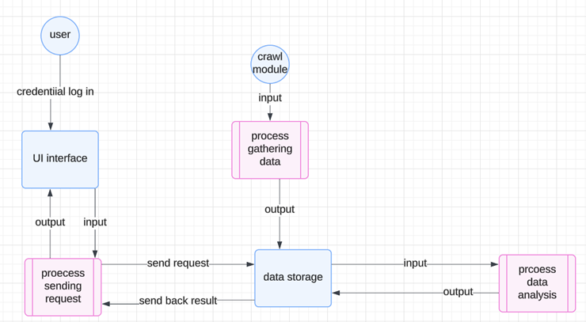
Data Flow and States
Key Elements of the Data Flow Diagram:
Entities: The primary participants or roles within the system, such as users, the Crawler Module, and the database.
Processes: The tasks performed within each module, such as “Data Collection,” “Data Storage,” and “Data Analysis.”
Data Stores: Locations where data is stored, such as a database or file system.
Data Flows: Indicate how data moves through the system. For example, a user requests analysis, and data flows from the UI to the Data Analysis Module, then returns with results.
Show Data Flow and State Transitions in Order:
Data Collection: The Crawler Module starts, and data flows to the database.
Data Storage: Data is stored in the database.
Data Query and View: Users request data from the database through the UI, and data is retrieved.
Data Analysis: Users trigger an analysis request; data flows to the Data Analysis Module for processing, which then returns a forecast.

Slide 17
Reports
Reporting Capabilities:
Sales Trends: Line charts and graphical visuals will be used to showcase sales trends during different parts of the year. This will allow the user to identify peak seasons for shows and identify popular venues.
Performance Analysis: In association with the sales trends, the performance analysis will identify profit and attendance rate achieved by venues and their ticket sales. The venue performance analysis will also be used in combination with band performance analysis to provide evidence for decision-based making when there are multiple options of venues.
Profitability: Profit analysis for each event of a venue will be reported to highlight the future optimal bookings based on the profit analysis of past events.
Presentation
Interactive Dashboards: Real-time visualizations of sales trends and performance metrics. Including side by side comparison between venue options.
Summary Reports: Weekly or monthly PDF/Excel reports summarizing key metrics with graphic visuals comparing current metrics to previous reports.
Detailed Charts and Graphs: Illustrates sales, attendance, and revenue rates.
Data Available:
Ticket Sales Data:
Date of sale—Timeline to showcase the number of tickets sold between booking time to night of the show. Highlights efficiency of promotion each venue provides.
Number of tickets sold—Online Vs. In-Person.
Price per ticket—Expanded to “Price average", depending upon whether different seats cost different prices.
Band Performance:
Total Profit
Attendance Rate Vs. Tickets Sold
Venue Metrics:
Revenue produced by venue on average per event
Occupancy rates—Amount of people the venue can hold
Cost of hosting events—Average cost of hosting per event

Slide 18
Achievements and Challenges
Achievements
Turned the prototype into a framework of how to create a sophisticated tool / website
Challenges
Synchronizing schedules and availability

Slide 19
Future Development
We will be saving this for future development:
Ticket Purchasing: Users will be able to buy tickets through this website.
We will most likely be saving these for future development:
Menus: Helpful to improve user navigation, even though there aren’t many pages and subpages to click between.
Configuration: Good to be able to customize the user experience.
Archiving: Could be useful for the data analysis part of the application, but it would require a lot of new implementations.

Slide 20
Thank you for your time! What questions do you have?

